Slide 1
Homology Search Tools
Kun-Mao Chao (趙坤茂)
Department of Computer Science and Information Engineering
National Taiwan University, Taiwan
WWW: http://www.csie.ntu.edu.tw/~kmchao

Slide 2
Homology Search Tools
Smith-Waterman
(Smith and Waterman, 1981; Waterman and Eggert, 1987)
FASTA
(Wilbur and Lipman, 1983; Lipman and Pearson, 1985)
BLAST
(Altschul et al., 1990; Altschul et al., 1997)
BLAT
(Kent, 2002)
PatternHunter
(Li et al., 2004)

Slide 3
Finding Exact Word Matches
Hash Tables
Suffix Trees
Suffix Arrays

Slide 4
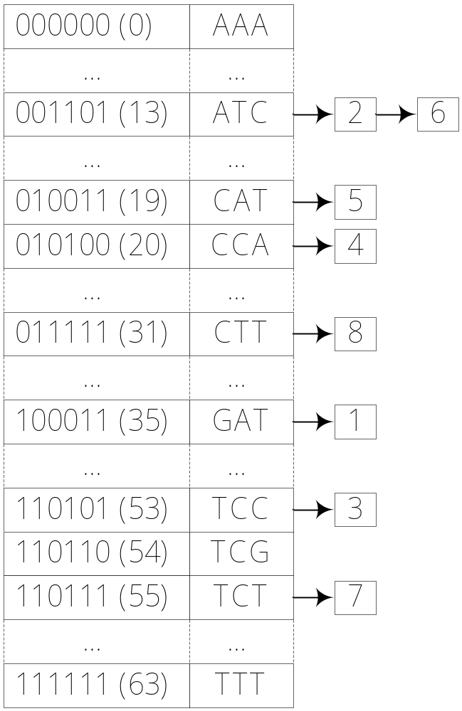
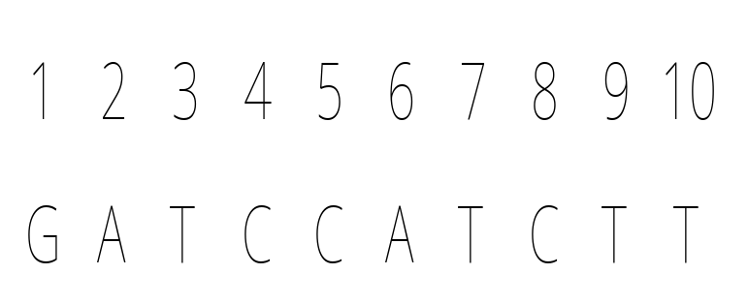
Hash Tables

Slide 5
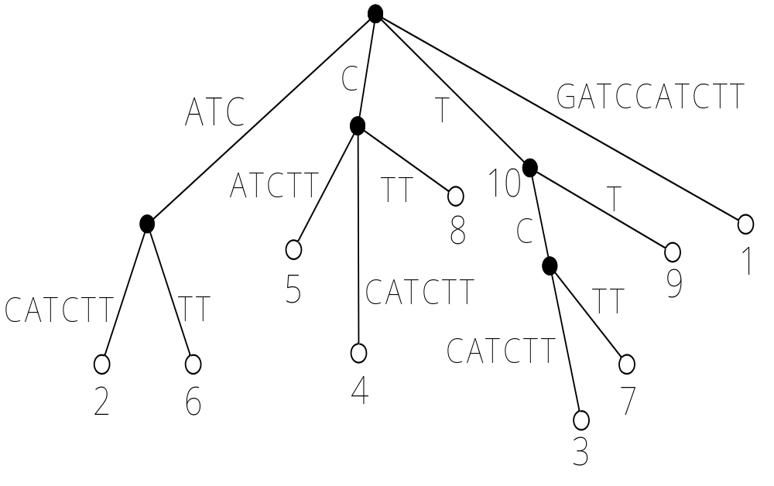
Suffix Trees (I)

Slide 6
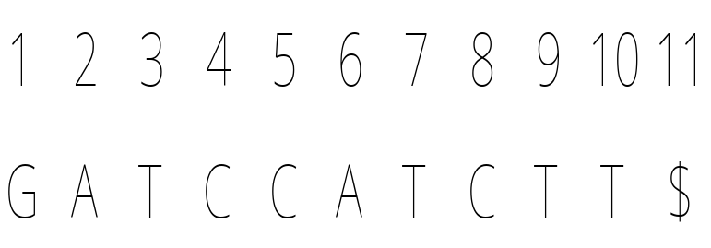
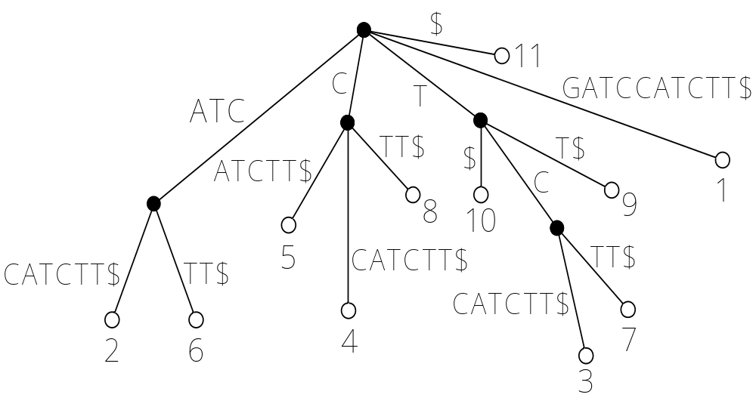
Suffix Trees (II)

Slide 7
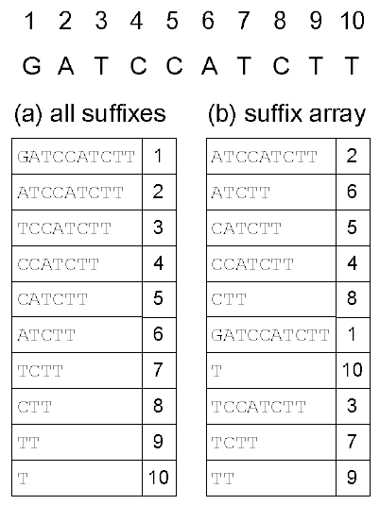
Suffix Arrays

Slide 8
FASTA
Find runs of identities and identify regions with the highest density of identities.
Re-score using PAM matrix and keep top scoring segments.
Eliminate segments that are unlikely to be part of the alignment.
Optimize the alignment in a band.

Slide 9
FASTA
Step 1: Find runes of identities and identify regions with the highest density of identities.
Sequence B
Sequence A

Slide 10
FASTA
Step 2: Re-score using PAM matrix and keep top scoring segments.

Slide 11
FASTA
Step 3: Eliminate segments that are unlikely to be part of the alignment.

Slide 12
FASTA
Step 4: Optimize the alignment in a band.

Slide 13
Band Alignment
(Joint work with W. Pearson and W. Miller)
Sequence A
Sequence B

Slide 14
Band Alignment in Linear Space
The remaining subproblems are no longer only half of the original problem. In worst case, this could cause an additional log n factor in time.
W
O(log n)
O(nW)*(1+1+…+1)
=O(nW log n)

Slide 15
Band Alignment in Linear Space

Slide 16
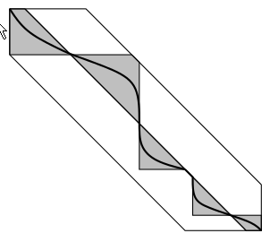
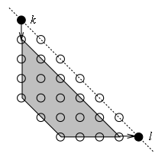
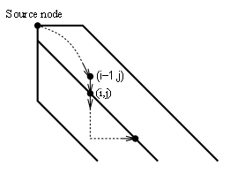
Splitting the problem into a few subproblems

Slide 17

Parallelogram

Slide 18
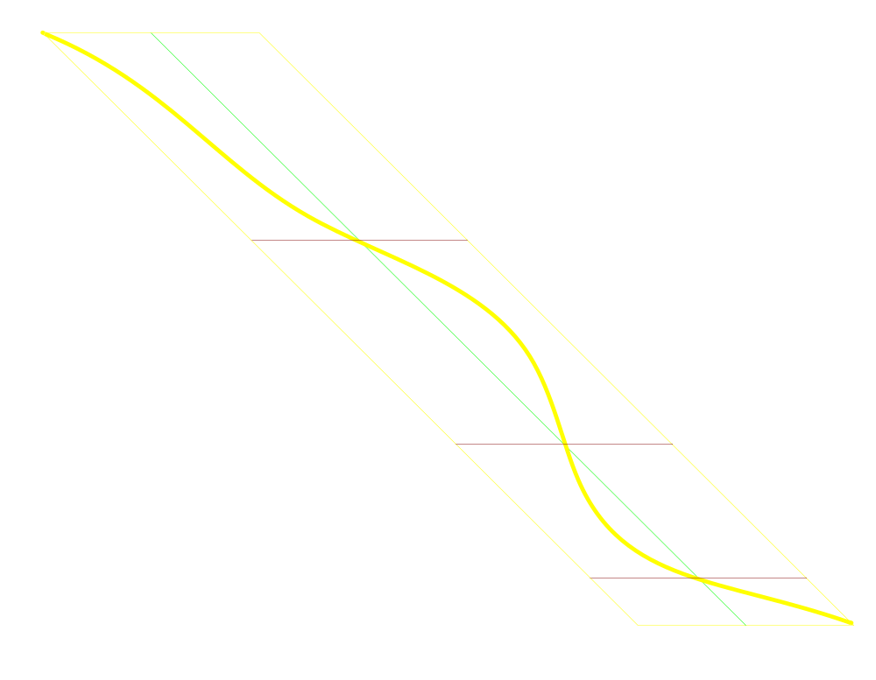
Parallelogram

Slide 19

Yet another partition line
Band width W

Slide 20
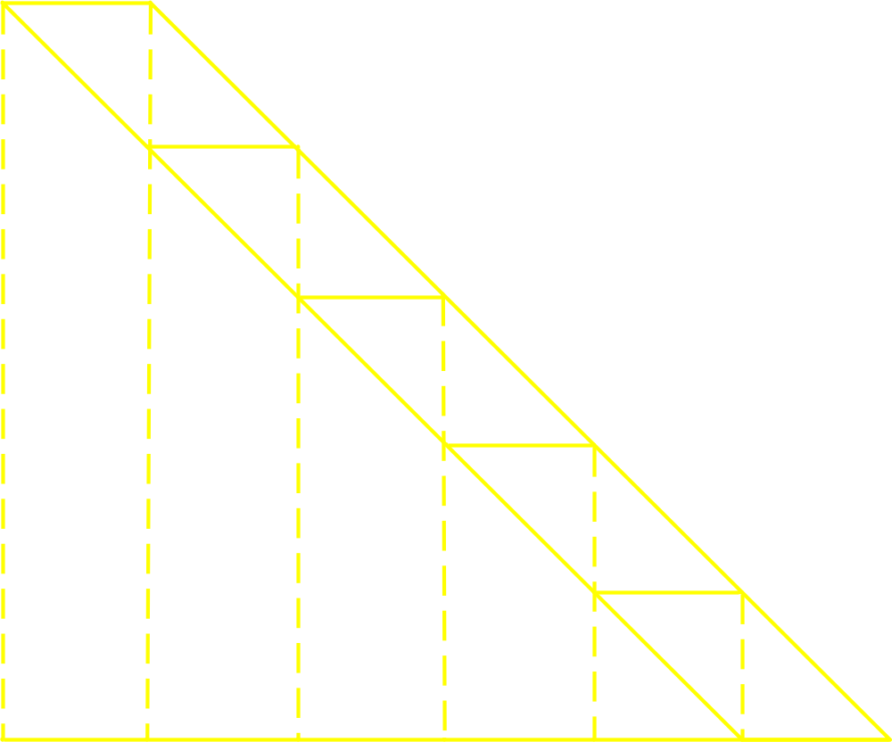
Yet another partition line
O(n)

Slide 21
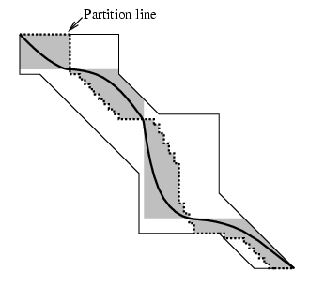
Arbitrary region

Slide 22
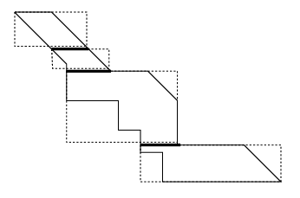
Arbitrary region

Slide 23
BLAST
Basic Local Alignment Search Tool
(by Altschul, Gish, Miller, Myers and Lipman)
The central idea of the BLAST algorithm is that a statistically significant alignment is likely to contain a high-scoring pair of aligned words.

Slide 24
The maximal segment pair measure
A maximal segment pair (MSP) is defined to be the highest scoring pair of identical length segments chosen from 2 sequences.
(for DNA: Identities: +5; Mismatches: -4)
The MSP score may be computed in time proportional to the product of their lengths. (How?) An exact procedure is too time consuming.
BLAST heuristically attempts to calculate the MSP score.
the highest scoring pair

Slide 25
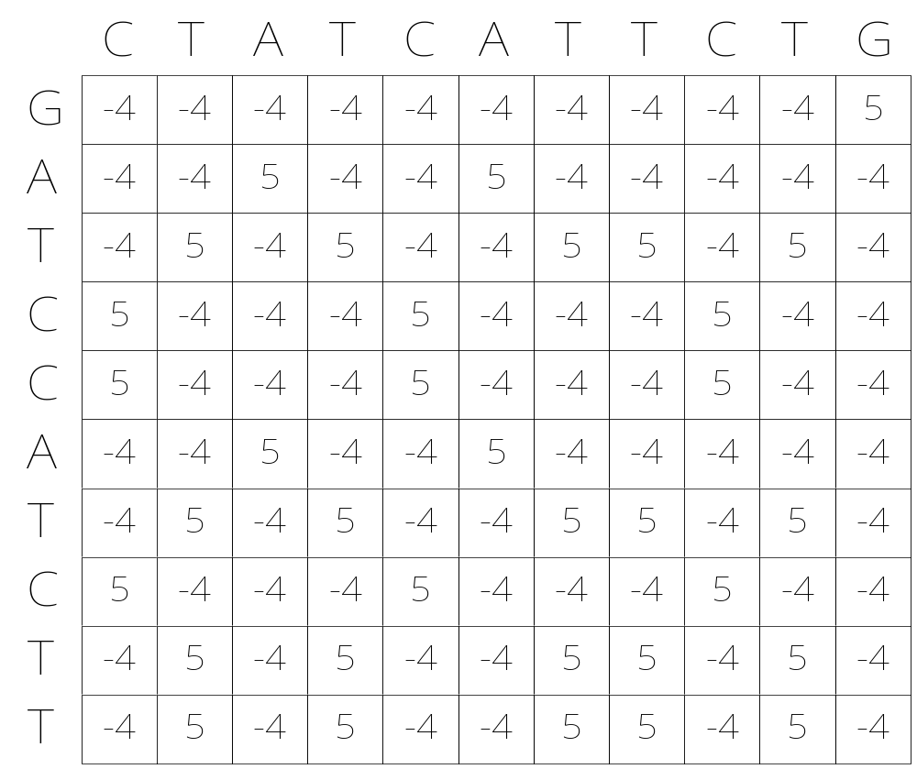
A matrix of similarity scores

Slide 26
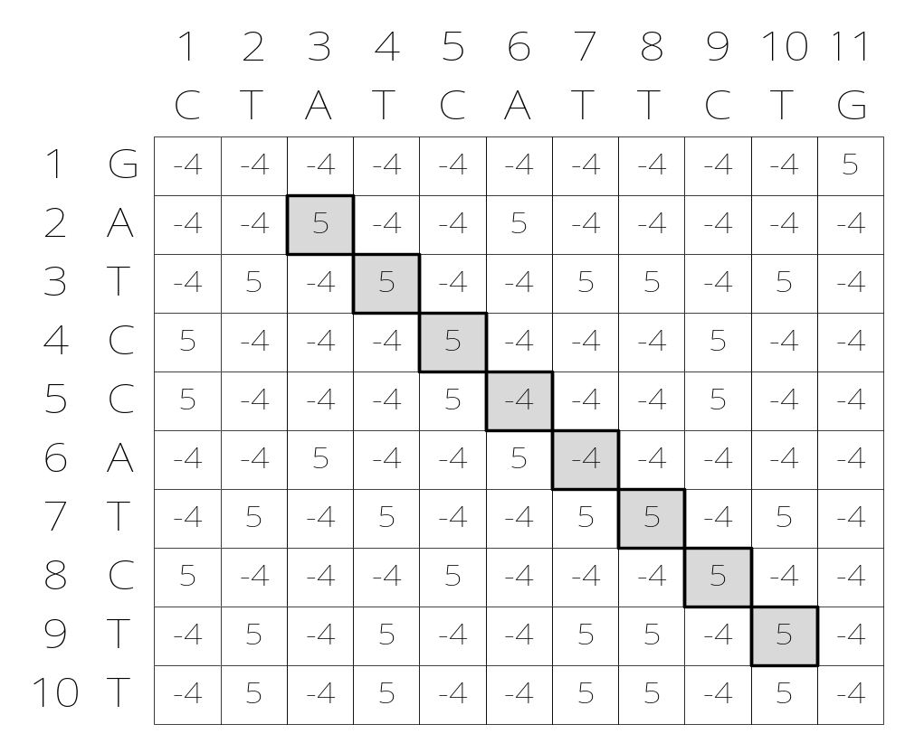
A maximum-scoring segment

Slide 27
BLAST
Build the hash table for Sequence A.
Scan Sequence B for hits.
Extend hits.

Slide 28
BLAST
Step 1: Build the hash table for Sequence A. (3-tuple example)
For DNA sequences:
Seq. A = AGATCGAT
12345678
AAA
AAC
..
AGA 1
..
ATC 3
..
CGA 5
..
GAT 2 6
..
TCG 4
..
TTT
For protein sequences:
Seq. A = ELVIS
Add xyz to the hash table
if Score(xyz, ELV) ≧ T;
Add xyz to the hash table
if Score(xyz, LVI) ≧ T;
Add xyz to the hash table
if Score(xyz, VIS) ≧ T;

Slide 29
BLAST
Step2: Scan sequence B for hits.

Slide 30
BLAST
Step2: Scan sequence B for hits.
Step 3: Extend hits.
BLAST 2.0 saves the time spent in extension, and considers gapped alignments.
hit
Terminate if the score of the extension fades away. (That is, when we reach a segment pair whose score falls a certain distance below the best score found for shorter extensions.)

Slide 31
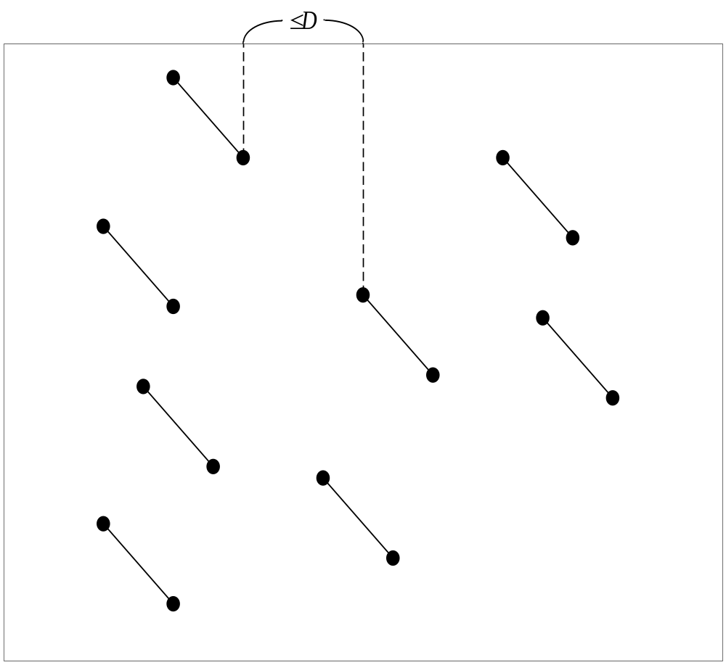
Gapped BLAST (I)
The two-hit method

Slide 32
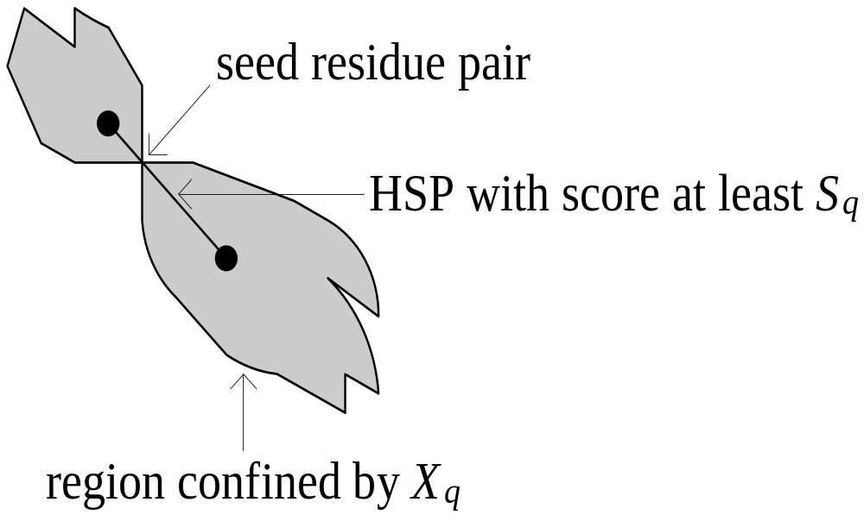
Gapped BLAST (II)
Confining the dynamic-programming

Slide 33
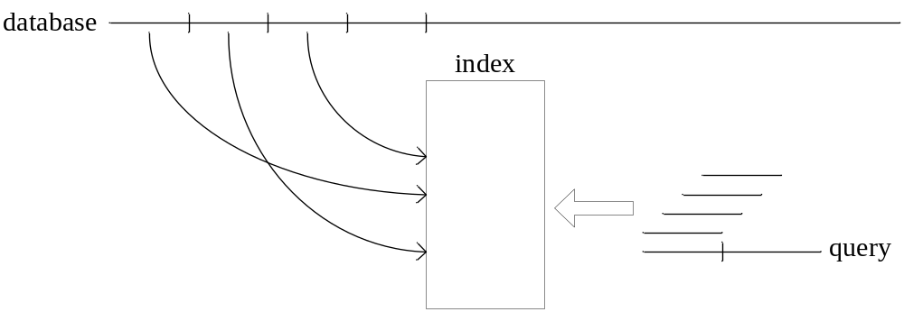
BLAT

Slide 34
PatternHunter – Spaced Seed

Slide 35
Define the Seed
Reference Bin Ma, John Tromp, Ming Li
Bioinformatics Vol. 18 no. 3 2002
Defining the seed:
  w -> weight or number of positions to match
    Blastn: 11 MegaBlast: 28
  model -> relative position of letters for each w
  l-> length of model “window”

Slide 36
Reference Bin Ma, John Tromp, Ming Li
Bioinformatics Vol. 18 no. 3 2002
Seed Parameters:
w = 11
letters:
*, 1
1 1 1 * 1 * * 1 * 1 * * 1 1 * 1 1 1
l = 18
model
1 – exact match required
* – no match required, any value
Patternhunter most sensitive model
Blastn seed is all “1”s

Slide 37
Consecutive vs. Nonconsecutive?
Reference Bin Ma, John Tromp, Ming Li
Bioinformatics Vol. 18 no. 3 2002
The non-consecutive seed is the primary difference and strength of Patternhunter
Blastn:
1 1 1 1 1 1 1 1 1 1 1
PatternHunter:
1 1 1 * 1 * * 1 * 1 * * 1 1 * 1 1 1

Slide 38
Example:
Reference Bin Ma, John Tromp, Ming Li
Bioinformatics Vol. 18 no. 3 2002
Consider the following two sequences:
GAGTACTCAACACCAACATCAGTGGGCAATGGAAAAT
|| ||||||||| |||||||| |||||| ||||||
GAATACTCAACAGCAACATCAATGGGCAGCAGAAAAT
What’s the differences in finding the seed between Blast and PatternHunter?

Slide 39
BLAST uses
“consecutive seeds”
Reference Bin Ma, John Tromp, Ming Li
Bioinformatics Vol. 18 no. 3 2002
In BLAST, we often use the consecutive model with weight 11.
GAGTACTCAACACCAACATCAGTGGGCAATGGAAAAT
|| ||||||||| |||||||| |||||| ||||||
GAATACTCAACAGCAACATCAATGGGCAGCAGAAAAT
→ 11111111111 → … →… … → 11111111111 ←
However, it fails to find the alignment in the two sequence.

Slide 40
Consecutive seeds
Reference Bin Ma, John Tromp, Ming Li
Bioinformatics Vol. 18 no. 3 2002
There’s also a dilemma for BLAST type of search.
Dilemma
  Sensitivity – needs shorter seeds
    too many random hits, slow computation
  Speed – needs longer seeds
    lose distant homologies

Slide 41
PatternHunter uses
“non-consecutive seed”
Reference Bin Ma, John Tromp, Ming Li
Bioinformatics Vol. 18 no. 3 2002
In PatternHunter, we often use the spaced model with weight 11 and length 18.
GAGTACTCAACACCAACATCAGTGGGCAATGGAAAAT
|| ||||||||| |||||||| |||||| ||||||
GAATACTCAACAGCAACATCAATGGGCAGCAGAAAAT
111*1**1*1**11*111

Slide 42
A trivial comparison between spaced and consecutive seed
Reference Ming Li, NHC2005
Consider 111 and 11*1.
To fail seed 111, we can use
  110110110110…
  66.66% similarity
But we can prove, seed 11*1 will hit every region with 61% similarity for sufficient long region.

Slide 43
Proof
Reference Ming Li, NHC2005
Suppose there is a length 100 region which is not hit by 11*1.
Skipping the first 0’s, we can break the region into blocks of 1ª0^{b}. Besides the last block, the other blocks have the following few cases:
  10^{b} for b>=1
  110^{b} for b>=2
  1110^{b} for b>=2
In each block, similarity <= 3/5.
The last block has at most 3 matches.
So, in total there are at most 61 matches in 100 positions. The similarity is <=61%.
  floor(97*0.6)+3=61

Slide 44
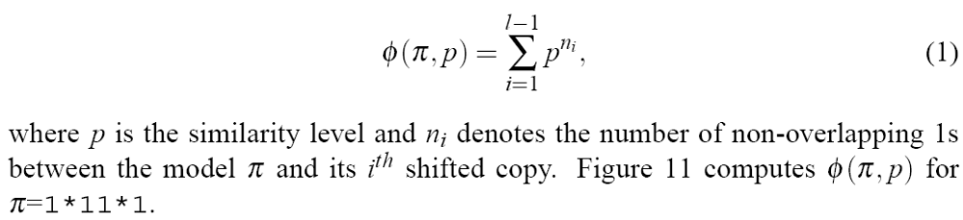
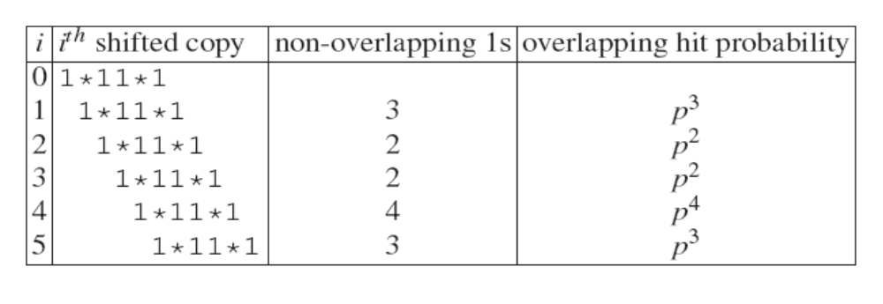
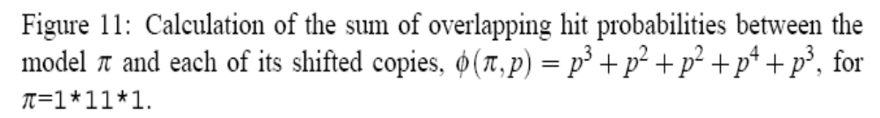
PatternHunter (I)

Slide 45
Formalize
Reference Ming Li, NHC2005
Given i.i.d. sequence (homology region) with Pr(1)=p and Pr(0)=1-p for each bit:
1100111011101101011101101011111011101
Which seed is more likely to hit this region:
  BLAST seed: 11111111111
  Spaced seed: 111*1**1*1**11*111
111*1**1*1**11*111

Slide 46
Expect Less, Get More
Reference Ming Li, NHC2005
Lemma: The expected number of hits of a weight W length M seed model within a length L region with homology level p is
(L-M+1)p^{W}
Proof. E(#hits) = ∑_{i=1 … L-M+1} p^{W} ■
Example: In a region of length 64 with p=0.7
  Pr(BLAST seed hits)=0.3
  E(# of hits by BLAST seed)=1.07
  Pr(optimal spaced seed hits)=0.466, 50% more
  E(# of hits by spaced seed)=0.93, 14% less

Slide 47
Why Is Spaced Seed Better?
Reference Ming Li, NHC2005
A wrong, but intuitive, proof: seed s, interval I, similarity p
E(#hits) = Pr(s hits) E(#hits | s hits)
Thus:
Pr(s hits) = Lp^{w} / E(#hits | s hits)
For optimized spaced seed, E(#hits | s hits)
111*1**1*1**11*111 Non overlap Prob
111*1**1*1**11*111 6 p⁶
111*1**1*1**11*111 6 p⁶
111*1**1*1**11*111 6 p⁶
111*1**1*1**11*111 7 p⁷
…..
For spaced seed: the divisor is 1+p⁶+p⁶+p⁶+p⁷+ …
For BLAST seed: the divisor is bigger: 1+ p + p² + p³ + …

Slide 48
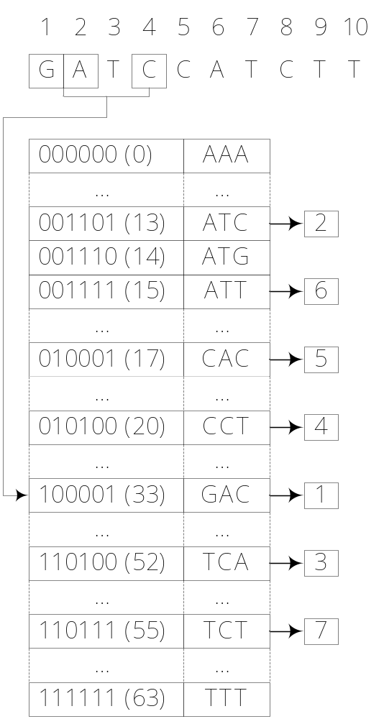
PatternHunter (II)
010111 (23)

Slide 49
Remarks
Filtering is based on the observation that a good alignment usually includes short identical or very similar fragments.
The idea of filtration was used in FASTA, BLAST, BLAT, and PatternHunter.

